Slide 1







Plant AI Doctor
INTERIM PROJECT PRESENTATION
Motivation
The Pivot
Novelty
Farmers struggle to distinguish chemical damage from biological diseases in tomato leaves. Visual similarity leads to wrong treatment and yield loss.
Shift from multiclass to binary classification: chemical vs. disease. This focus is clearer and technically more feasible for data limitations.
One of the first datasets for chemical vs. biological distinction, leveraging Generative AI for advanced synthetic data generation.

Slide 2
Scientific Literature Review
Paper (Year) | Task | Methods | Data | Results | Relation to Project
Tomato Leaf Disease Segmentation (2022) | Disease classification + segmentation | U-Net segmentation + CNN classifier | 18K tomato leaf images | High accuracy: segmentation improves performance | Works only on diseases, not chemical vs disease (our novelty)
Efficient Tomato Disease Detection (2025) | Disease detection (efficient model) | Custom CNN model (E-TomatoDet) | Tomato leaf dataset | High detection performance (mAP ≈ 97.2%) | Shows SOTA disease detection, but no chemical damage classification
Review of Tomato Leaf DL Methods (2025) | Review of DL methods for tomato leaf diseases | Survey of CNNs, segmentation, preprocessing | Multiple tomato datasets (e.g., PlantVillage) | Identifies major limitations in datasets | Highlights gap: no dataset for chemical vs disease

Slide 3



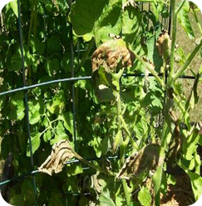
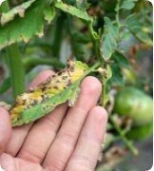
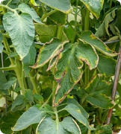
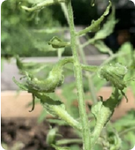




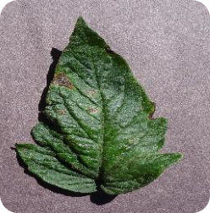
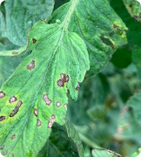
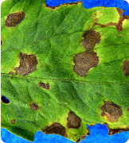
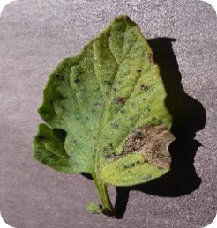
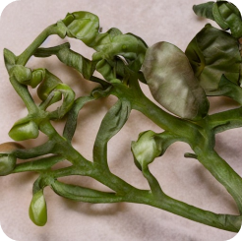
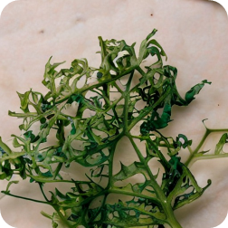
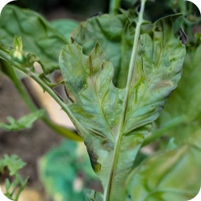
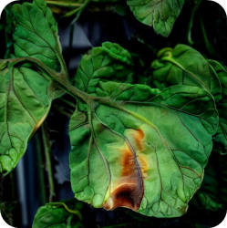



Dataset Analysis & Visual Samples
Dataset Components
•
Real Images: 157 total images (RGB).
•
Chemical damage: 67 images.
•
Biological disease: 90 images.
•
Labels: assigned at the image level based on damage type
Chemical Damage
Chemical Damage
Chemical Damage
Chemical Damage
EDA & Strategy
•
Class Imbalance: Slight (chemical < biological).
•
Split: Train / Val / Test (no overlap).
Format: RGB images, varying resolutions and backgrounds.
•
Biological Disease
Biological Disease
Biological Disease
Biological Disease
Future Strategy:
Synthetic data generation via Stable Diffusion and ControlNet to address data scarcity and balance classes.
Synthetic Chemical Damage
Synthetic Chemical Damage

Slide 4

Baseline Solution and Results
Baseline Approach: Pretrained ResNet18 CNN adapted for binary classification. Uses minimal modifications. No synthetic data used at this stage
Performance Assessment
The perfect accuracy is likely due to:
Dataset | Accuracy
Validation (real) | 100%
Test (real) | 100%
•
Small size of current real dataset.
•
Powerful pretrained ResNet model.
•
Strong visual cues in the dataset.
Conclusion: Results suggest potential overfitting. Accuracy alone is insufficient to assess model robustness.
No classification errors were observed on the validation and test sets.

Slide 5
Execution Roadmap
Step | Scope / Description | Models & Techniques | Expected Outcome
1 | Synthetic chemical data generation | Stable Diffusion | Balanced chemical image dataset
2 | Realistic damage pattern refinement | Inpainting, ControlNet | Localized, realistic damage areas patterns
3 | Dataset Expansion | Merge Real + Synthetic (train only) | Robust training set for higher generalization
4 | Updated Model Retraining | ResNet18 (Fine-tuning) | Enhanced classifier performance
5 | Robustness Validation | Crop / Illumination changes | Verified stability in varying conditions
6 | Final Submission | Results summary and presentation | Completion of Final Presentation

